Slide 1
FU TIMETABLING

Slide 2
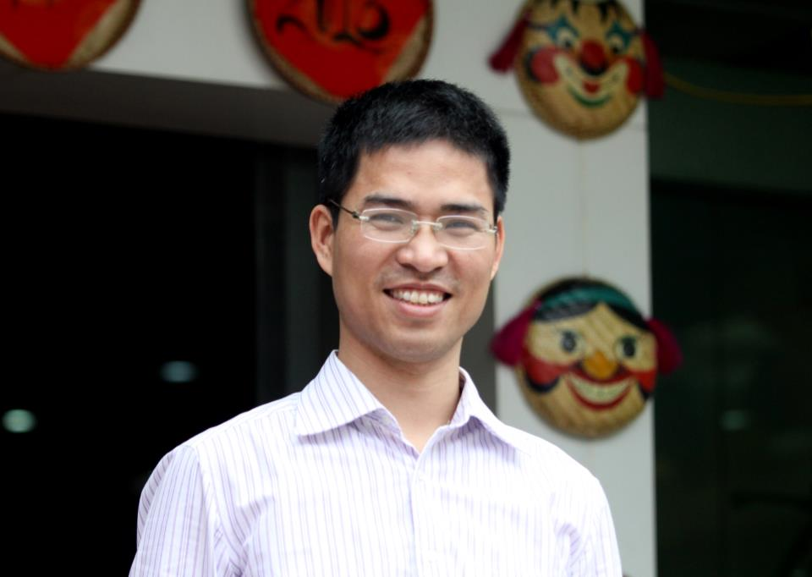
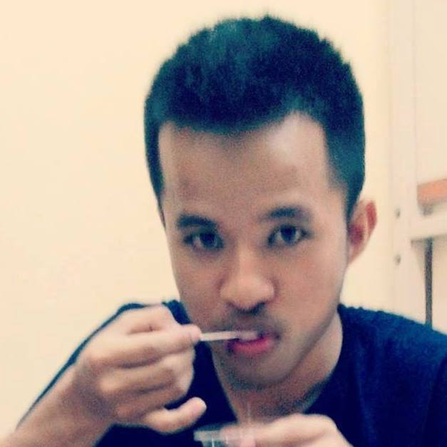
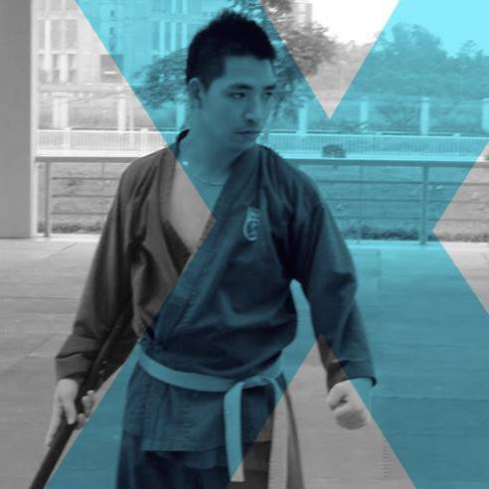
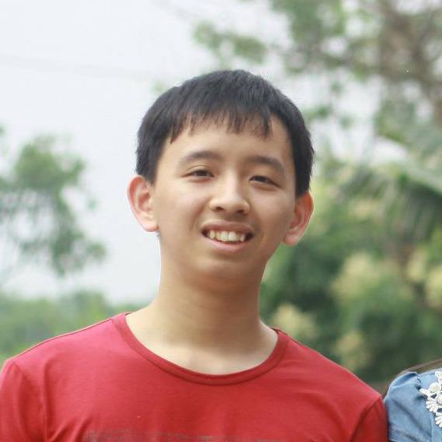
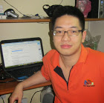
TEAM MEMBER
SUPERVISORS
Mr. DungPQ
Mr. TrungNT
Team

Slide 3










TECHNOLOGIES
SPRING
MySQL
FXML
SPRING DATA
LOG4J
Choco
Tomcat
Hibernate
POI
Open-cbls

